Slide 1
First Order Logic
in AI
Artificial Intelligence - Presentation
Notes:
Let’s begin with why I choose this topic? I was the last one to pick the topic and this leftover caught my eye.
Why do you need to pay attention to this presentation?
FOL is an important concept because it is taught in a syllabus of some schools. There is 2hour long lecture for PL and FOL in stanford online. But I am teaching you here as a presentation. This is 10 hours long research & my work to implement in 20 minutes.

Slide 2
HI!
I am K-gen- I am a passionate programmer and a music enthusiast. In my free time- I like to play CS 2- and read books.
Notes:
So- as I was thinking about how to present the idea about FOL to you- I began to thought about what is logic?

Slide 3
Logic?
What is meant by Logic?

Slide 4
Why do we need logic?
Why?
Notes:
Logic allows us to express very complicated and big things (like modelling the world knowledge) by using some kind of formulas.

Slide 5
Types of Logics
Propositional logic with only Horn clauses
Propositional logic
Modal logic
First-order logic with only Horn clauses
First-order logic
Second-order logic
Notes:
Today- we are briefly talking about Propositional Logic- and bring the focus on FOL why PL is not enough

Slide 6
Types of Logics
Propositional logic with only Horn clauses
Propositional logic
Modal logic
First-order logic with only Horn clauses
First-order logic
Second-order logic
- – – – –
Notes:
Today- we are briefly talking about Propositional Logic- and bring the focus on FOL why PL is not enough

Slide 7
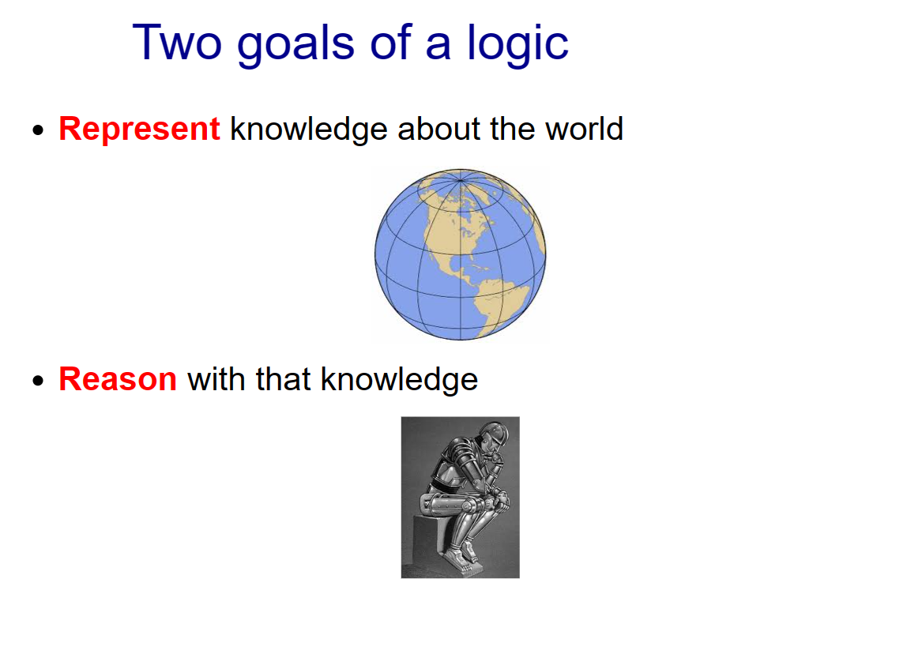
Notes:
Even hardware can represent the knowledge but we have to use that knowledge in a way to reason with it.

Slide 8
Notes:
Even hard disk can represent the knowledge but to truly benefit from that knowledge, one must actively use and engage with it in a thoughtful manner.

Slide 9
Two Goals of mine
Present this topic to you very clearly

Slide 10
Two Goals of mine
Present this topic to you very clearly
Make you learned something new after this time

Slide 11
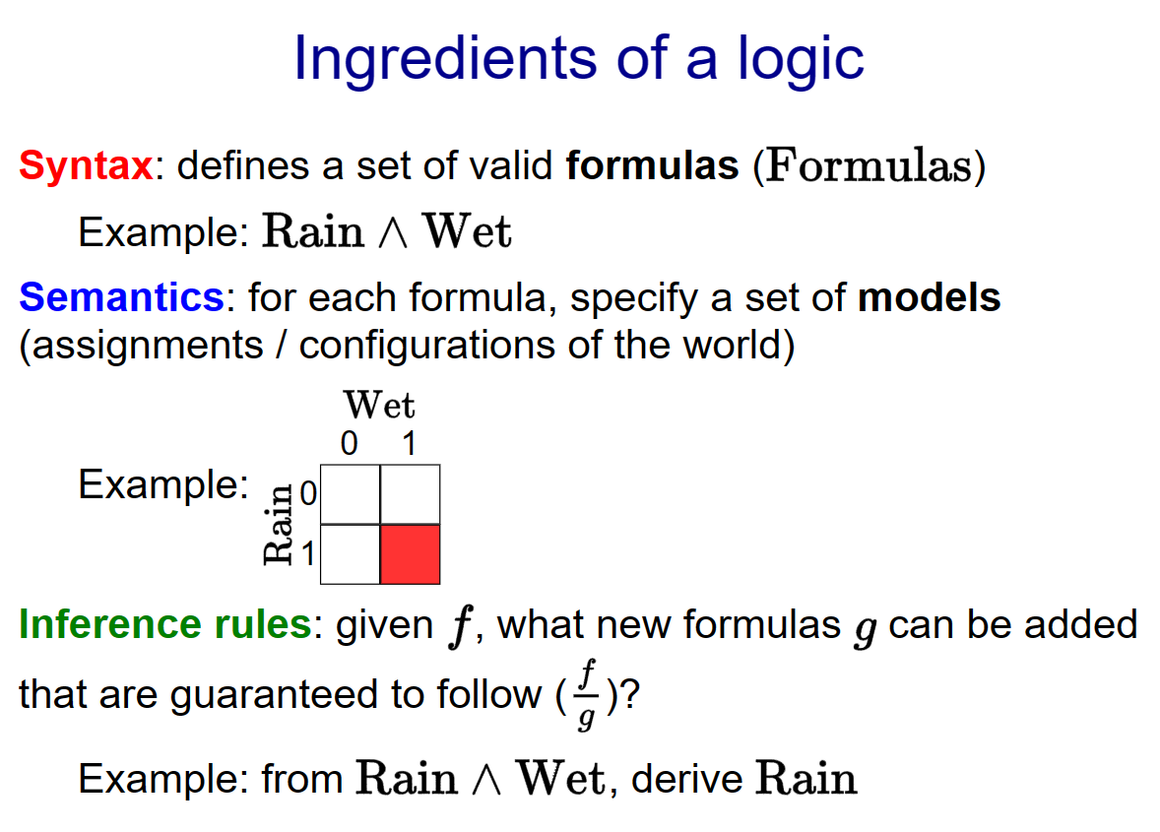
Notes:
Syntax means what kind of expression are valid.
Semantics specifies the meaning of a formula.
Inference rules allow us to take various formula to do different thing. For example- if I tell you that it's raining and wet- then you should be able to conclude that it is also raining (obviously)

Slide 12
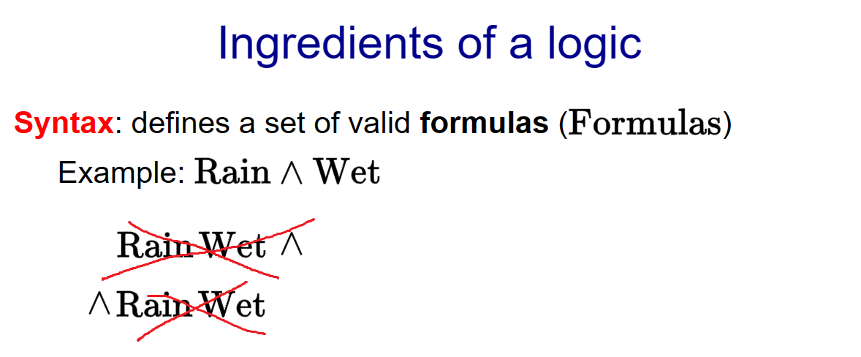
Notes:
Syntax means what kind of expression are valid. Semantics specifies the meaning of a formula.
Inference rules allow us to take various formula to do different thing. For example- if I tell you that it's raining and wet- then you should be able to conclude that it is also raining (obviously)

Slide 13
Notes:
Syntax means what kind of expression are valid. Semantics specifies the meaning of a formula.
Inference rules allow us to take various formula to do different thing. For example- if I tell you that it's raining and wet- then you should be able to conclude that it is also raining (obviously)

Slide 14
Notes:
Syntax means what kind of expression are valid. Semantics specifies the meaning of a formula.
Inference rules allow us to take various formula to do different thing. For example- if I tell you that it's raining and wet- then you should be able to conclude that it is raining (obviously)

Slide 15
Syntax versus Semantics
Syntax: what are valid expressions in the language?
Semantics: what do these expressions mean?
Different syntax- same semantics (5):
2 + 3 ←—------------→ 3 + 2
Notes:
Even 2+3 & 3+2 are diff syntax syntax they represent the same semantics +

Slide 16
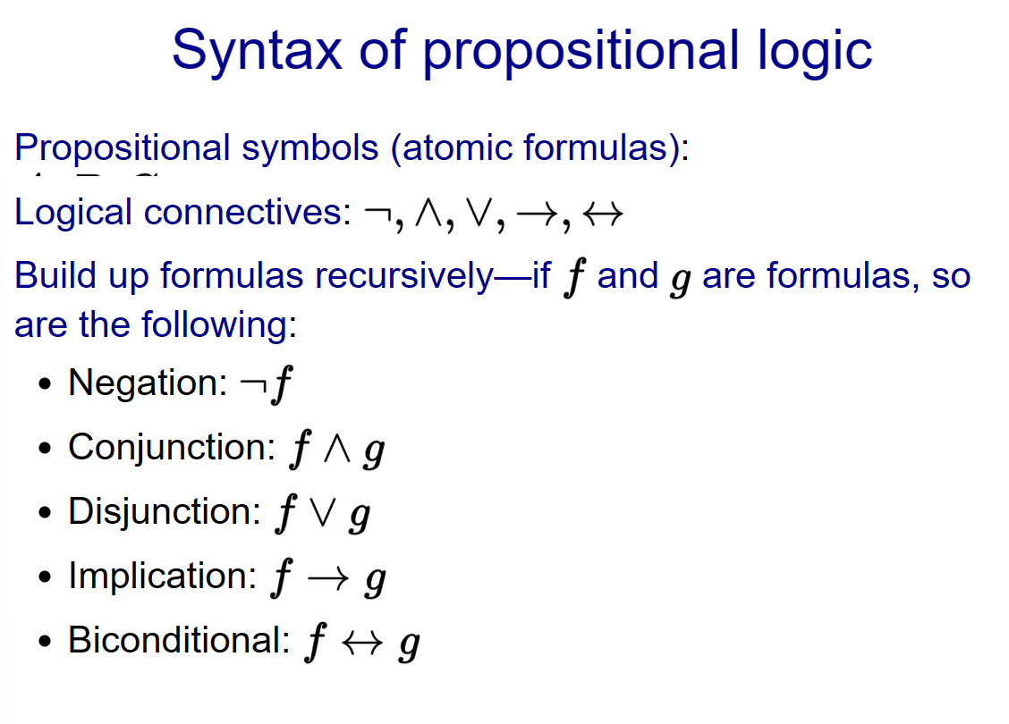
Notes:
These are some syntax in PL

Slide 17
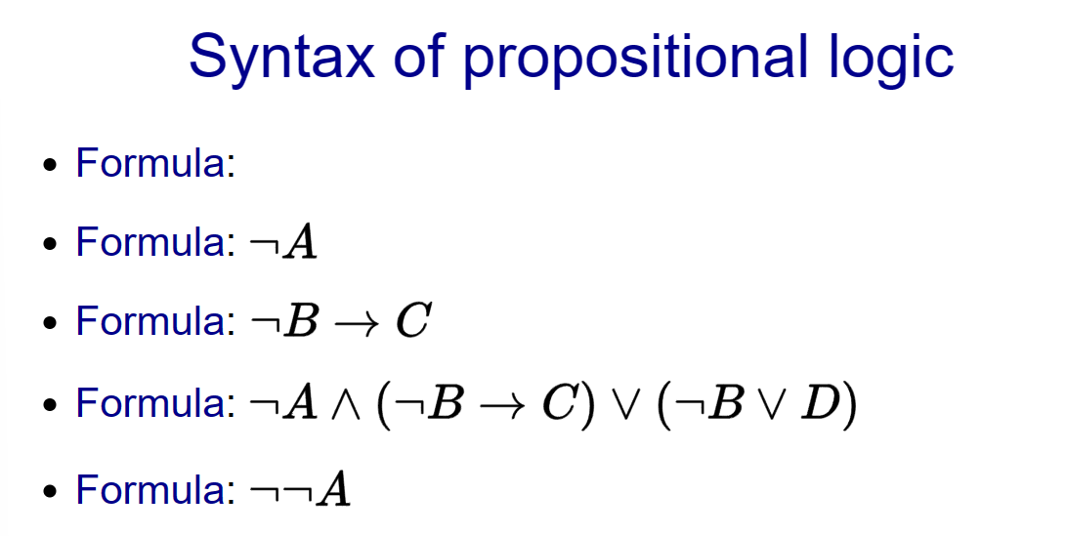
Notes:
And here are some formulas

Slide 18
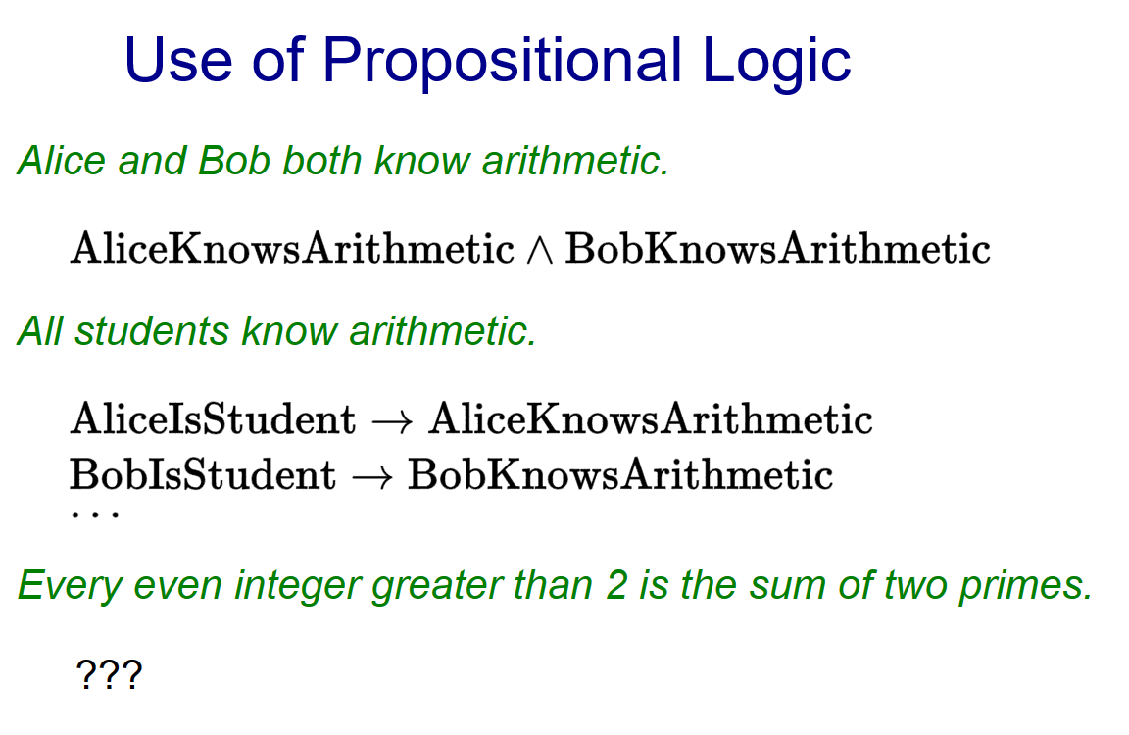
Notes:
I think it would be illegal if i do not show you Propositional logic in example

Slide 19
Notes:
So, this is how it is implemented

Slide 20
Notes:
Lets try to implement this

Slide 21
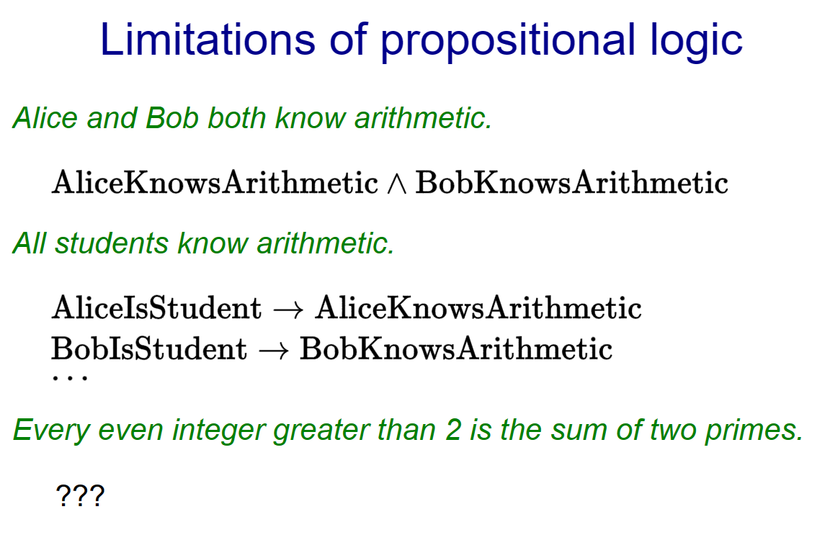
Notes:
Now, it’s a problem, because the list will grow very bigger. And the PL will be very clunky.

Slide 22
Notes:
But, how about this one. This could take forever

Slide 23
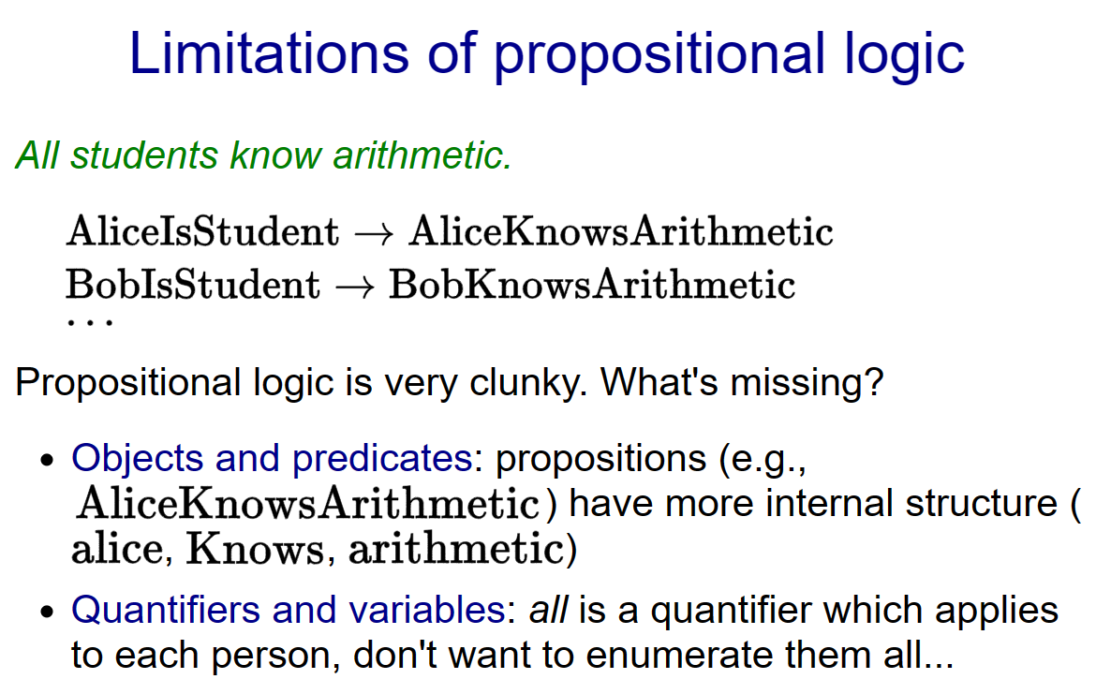
Notes:
You can see here, Propositional logic is just storing the facts. Like statement p(x) or P = .

Slide 24
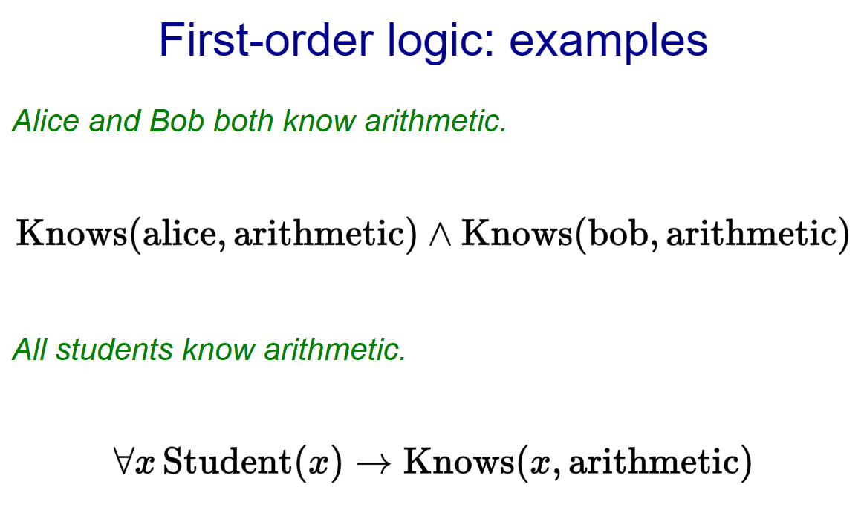
Notes:
Before formally defining things FOL- let's look at two examples. First-order logic is basically propositional logic with a few more symbols.

Slide 25
Notes:
Before formally defining things- let's look at two examples. First-order logic is basically propositional logic with a few more symbols.

Slide 26
Notes:
How simple and beautiful this looks

Slide 27
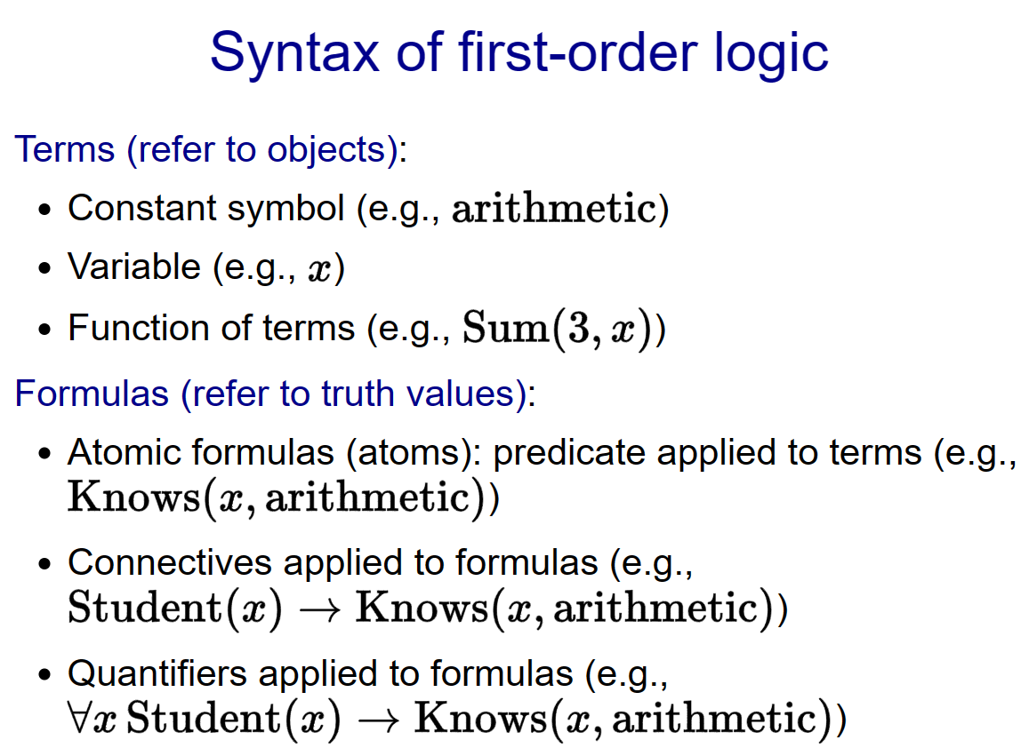
Notes:
In propositional logic- everything was a formula (or a connective). In first-order logic- there are two types of beasts: terms and formulas. There are three types of terms: constant symbols (which refer to specific objects)- variables (which refer to some unspecified object to be determined by quantifiers)- and functions (which is a function applied to a set of arguments which are themselves terms).

Slide 28
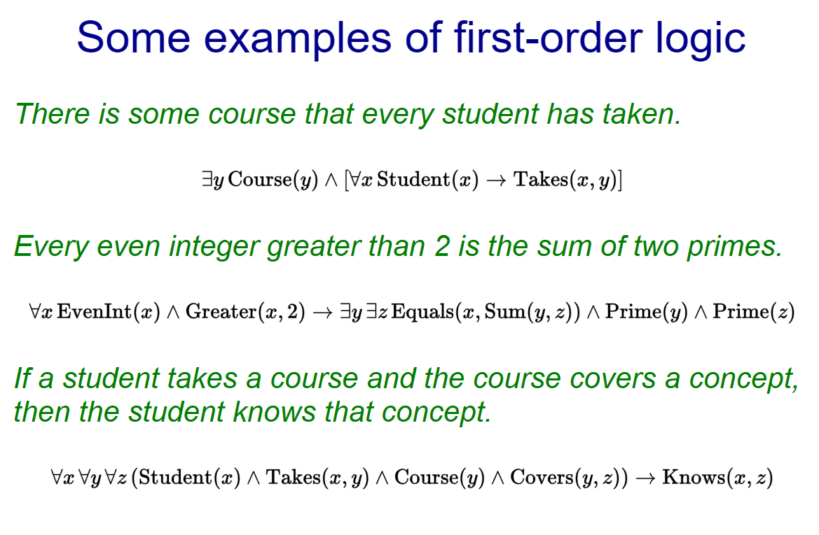

Slide 29
Identifiers
Existential quantification
Universal quantification
∀
∃
∀x P(x)
∃ x P(x)

Slide 30
Universal Quantification
Universal quantification
"For all x- P(x) holds"-
"for each x- P(x) holds" or
“for every x- P(x) holds"
"All CU CS majors should take an AI course." could be transformed into the
logical form- ∀x P(x)
P(x) is the predicate denoting: x should take an AI course- where x represents a CU CS major.
This quantified expression asserts that for all x- P(x) is true.
∀
∀x P(x)
Notes:
This Universal quantifiers means, X hold true for its sets

Slide 31
Existential quantification
Existential quantification
"There exists an x such that P(x)"
"There is at least one x such that P(x)"
"Someone hates Mac computers" could be transformed into the
propositional form- ∃xH(x)
H(x) is the predicate denoting: x hates Mac computers.- where x represents all individuals..
This quantified expression asserts that there exists x- P(x) is true.
∃
∃xH(x)
Notes:
X can be me- professor V oy my friend Gio

Slide 32
Propositional Logic
It is a way to data representation in a simple logical form.
Such that:- TRUE or FALSE.

Slide 33
Propositional Logic
Propositional logic is declarative
Propositional logic has very limited expressive power
Propositional logic is compositional
Propositional logic allows partial/disjunctive/negated information(unlike most data structures and databases)
Meaning in propositional logic is context-independent(unlike natural language- where meaning depends on context)
Notes:
These are same things what I just explain but in theory

Slide 34
First Order Logic
It is a robust technique to represent objects as well as their relationships. Unlike propositional logic- First Order Logic in Artificial Intelligence doesn't only include facts but also different other entities like objects- relations- functions.

Slide 35
Topic I did not covered
-Models
-Interpretation functions
-Knowledge Base
-Entailment
-Contradiction
-Satisfiability
Notes:
These are some topics I did not covered not because they are not important but because due to limited time. You can of course check on online if you want to go deeper.

Slide 36

Just a picture from Web.

Slide 37

SWI-PROLOG
This is the tool that uses the concept of FOL.
Notes:
This is one of the top example to show the FOL demonstration

Slide 38
Simple- yet very powerful
https://www.swi-prolog.org/Download.html

Slide 39
Open source - GitHub
https://github.com/SWI-Prolog
Notes:
If you want to contribute then-

Slide 40
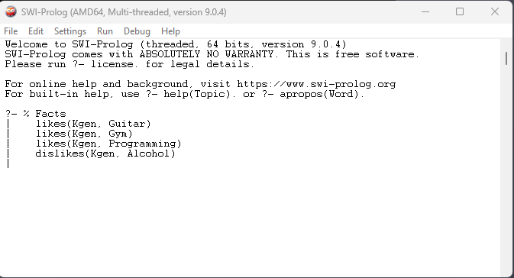
THIS IS A CLI

Slide 41
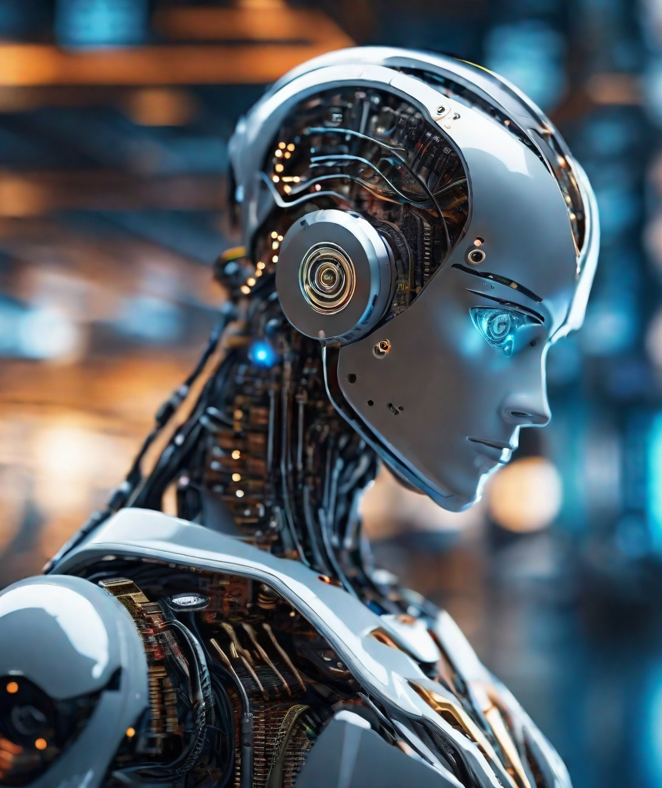
Ok- let’s see the real example
I will run the actual program where I have interpreted the meaningful examples.

Slide 42
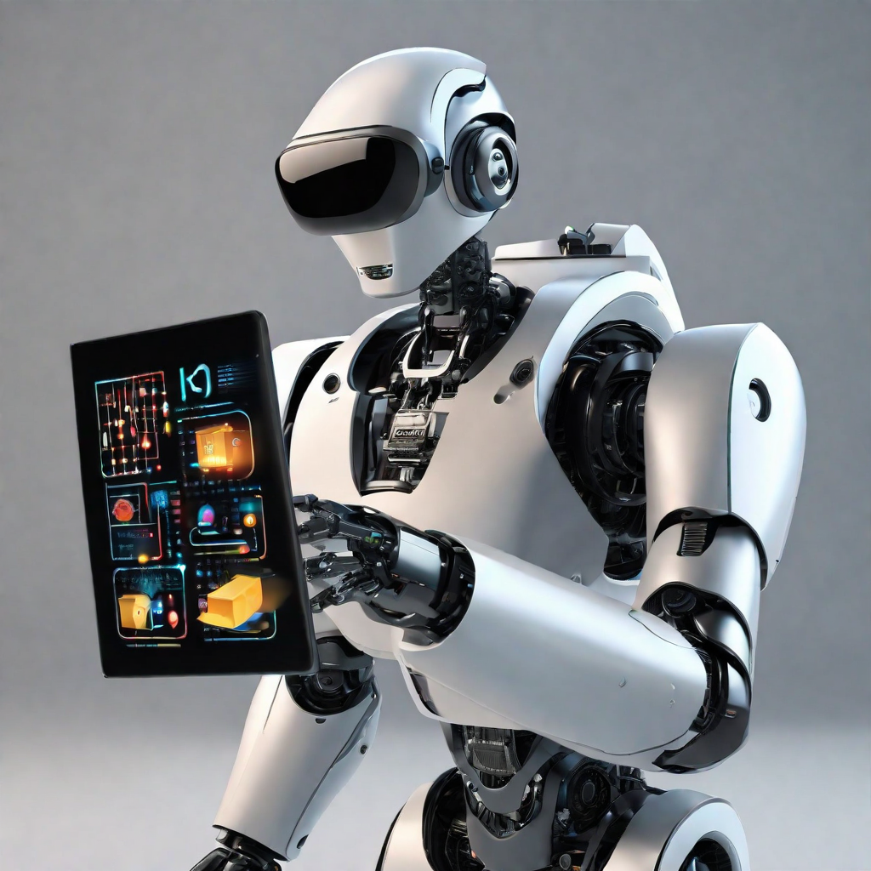
Just a picture from Web.

Slide 43
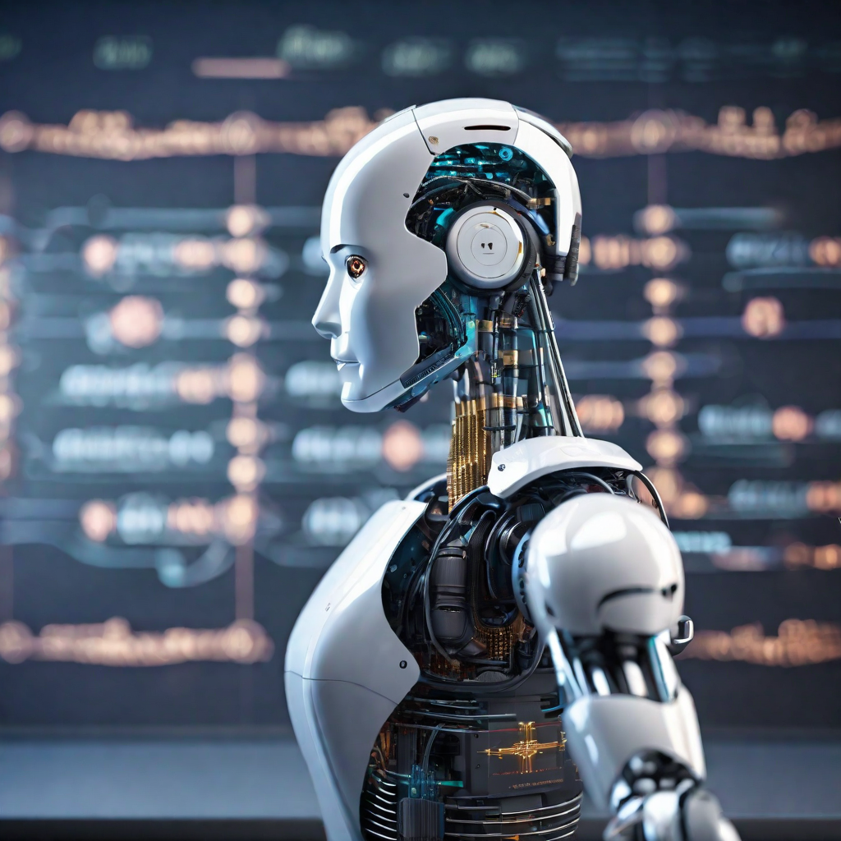
Just a picture from Web.
Notes:
The reason I kept this picture here is- I feel amazed by looking at this robot.

Slide 44
Ethical/Social Issues
The major concern of AI

Slide 45
Ethical/Social Issues
Bias and Fairness
Transparency and Accountability
Privacy Concerns:
Job Displacement:
Security Risks:
Explainability:
others

Slide 46
Ethical/Social Issues
Bias and Fairness
Security Risks
The use of First-Order Logic (FOL) in AI systems may inherit biases present in the data used for training. This can lead to unfair or discriminatory outcomes- reinforcing existing social biases.
AI systems using FOL may be susceptible to adversarial attacks- where malicious actors manipulate input data to deceive the system. Ensuring robust security measures is essential to prevent unauthorized access and manipulation of AI models.

Slide 47
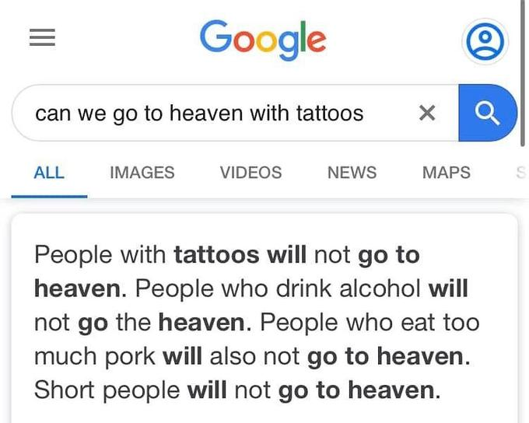
Notes:
Biasness like this causes too much problem- specially short people like me.

Slide 48
Economics and Company Profiles
FOL

Slide 49
Economics and Company Profiles
Economic Impact: The use of FOL in AI has significant economic implications. Companies adopting these technologies may experience increased efficiency- reduced operational costs- and improved decision-making. However- there may also be economic challenges- such as job displacement and the need for substantial investments in AI infrastructure.

Slide 50
Company Profiles
Google: Known for incorporating FOL in various AI applications- Google utilizes advanced logic systems to enhance search algorithms- language processing- and other services.
IBM: IBM employs FOL in its AI solutions- particularly in areas like healthcare and finance- demonstrating the versatility of these technologies across industries.
Amazon: Amazon's use of FOL is notable in its recommendation systems and logistics optimization- showcasing the impact on customer experience and operational efficiency.
Tesla: Tesla utilizes FOL in its autonomous driving technology- showcasing the role of logic-based AI in the automotive industry.

Slide 51
So far we covered
What is Logic?
Symbols & Syntax
What is PL?
Mathematical identifier
Ethical issue & Economics
SWI-PROLOG
Why do we need Logic?
Semantics
What is FOL?
Universal & Existential identifiers
And how to manage them
How to download & How to use?

Slide 52
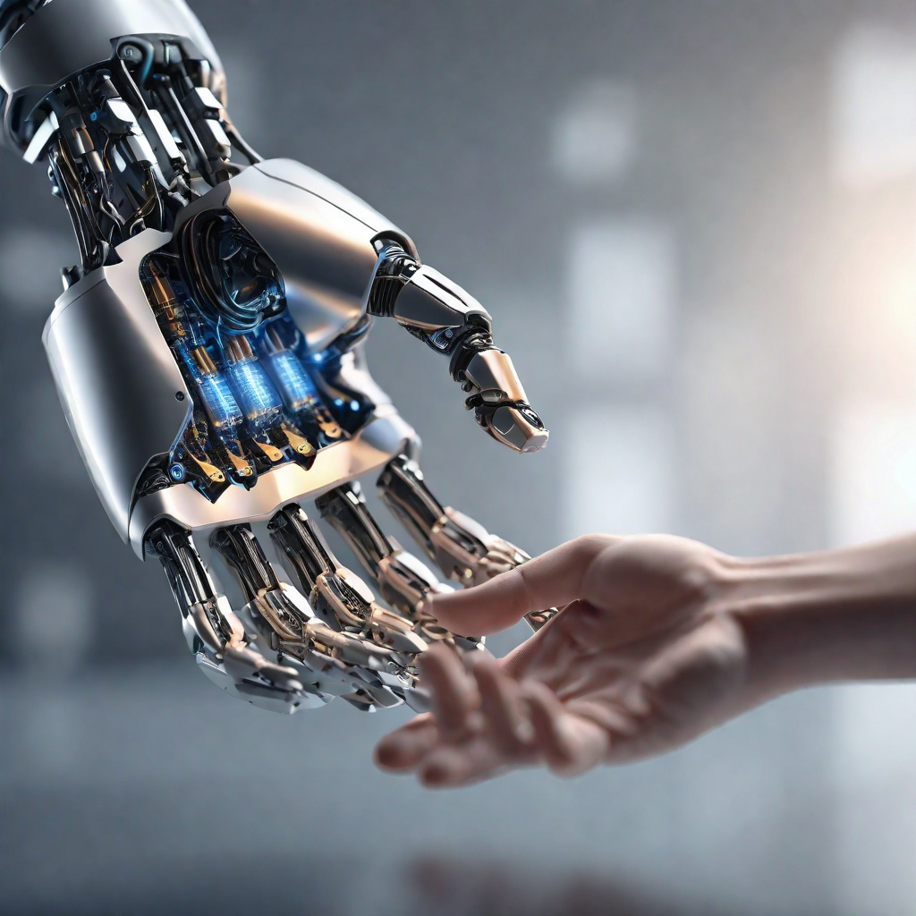
Summary
Propositional logic assumes world contains only facts.
first-order logic considers the world contains objects- relations- functions
Logics consists of syntax & semantics
Existential identifier means x exists in the sets and Universal identifiers all x belongs to the sets
Why Ethical/Social issues is concerning as well as economics & company profiles
Learnt about downloading and using the SWI-PROLOG
Notes:
Describe symbols and semantics

Slide 53
Questions please?
So- it is your turn to ask me questions.
Notes:
I will reply with best of my knowledge and ability

Slide 54
Fancy stuff isn’t gonna work- unless you learnt the fundamentals.
Randy Pausch
Notes:
A former professor in Carnegie Mellon- this has been stuck with me forever. If you did not understand very much, The takeaway of this presentation is that Logic help us to represent the world model to the computer by using mathematical formula.

Slide 55

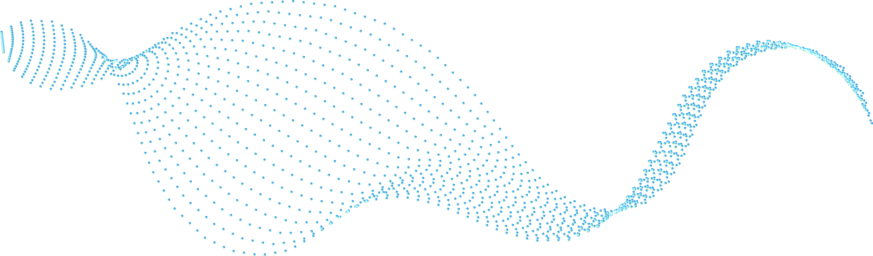


Thank You for watching
If you have any questions?
kkhatri@caldwell.edu
862-XXX-XXXX
Caldwell Univesity

Slide 56
Work citation
References:
First-order logic in AI. Scaler. https://www.scaler.com/topics/artificial-intelligence-tutorial/first-order-logic-in-ai/
First-order logic in artificial intelligence. JavaTpoint. https://www.javatpoint.com/first-order-logic-in-artificial-intelligence
What is First-order Logic in Artificial Intelligence? Educative. https://www.educative.io/answers/what-is-first-order-logic-in-artificial-intelligence
First-order Logic. AutoBlocks Glossary. https://www.autoblocks.ai/glossary/first-order-logic

